Slide 1
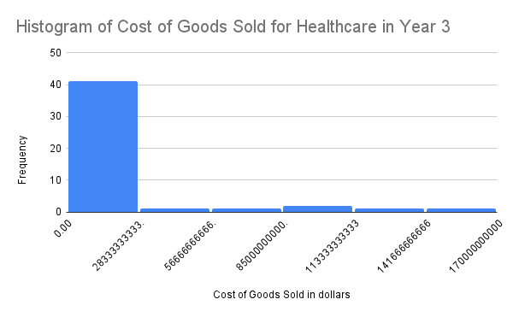
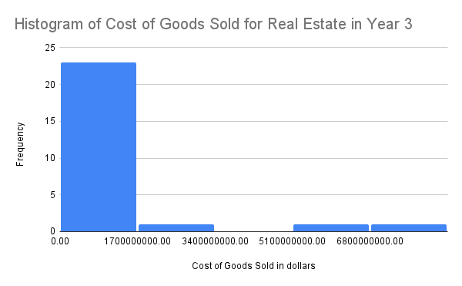
What are the similarities and differences between the Healthcare and Real Estate sectors in terms of Costs of Goods Sold in Year 3?
In the slide below we have a statistical summary and histograms for the costs of goods sold in the health care and real estate sectors.
We can clearly see that both distributions are right-skewed or positively skewed, with their mean being higher than the median. The mean for real estate is approximately $1.2 billion whereas the mean for healthcare is over 13 times more (about $16.4 billion). The median for real estate is about $824 million and the median for healthcare is about $3.8 billion.
The standard deviation for real estate is approximately $1.8 billion compared to the healthcare sector which is far more higher ($36 billion). This means that the healthcare companies incur more expenses for the production of goods with more than 50% of the companies spending over $3.7 billion in the costs of goods and services up to $168 billion, while 50% of real estate companies spend at least $824 million up to $8 billion maximum and some real estate companies spend nothing at all for COGS. There is a wider spread and larger differences between healthcare companies than real estate companies.
link to spreadsheet

Slide 2
Summary Statistics
 | Real Estate COGS | Health Care COGS
std | 1781177734 | 36085067140
max | $8,050,222,000 | $167,634,000,000
min | $0 | $60,987,000
range | $8,050,222,000 | $167,573,013,000
mean | $1,212,778,769 | $16,424,897,915
median | $824,064,000 | $3,788,000,000

